Slide 1
Jena RDF API Tutorial: Guardians of The Galaxy
By: Marshanah Taylor

Slide 2
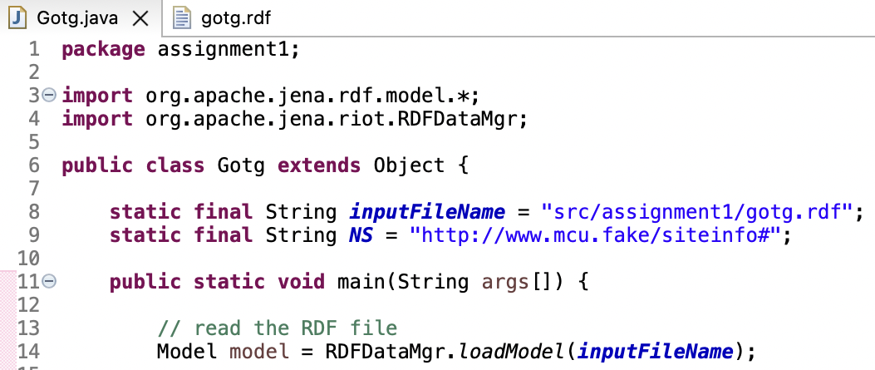
Reading the “gotg.rdf” File In
Read in the RDF file with the inputFileName “gotg.rdf” (Shown in line 14).

Slide 3
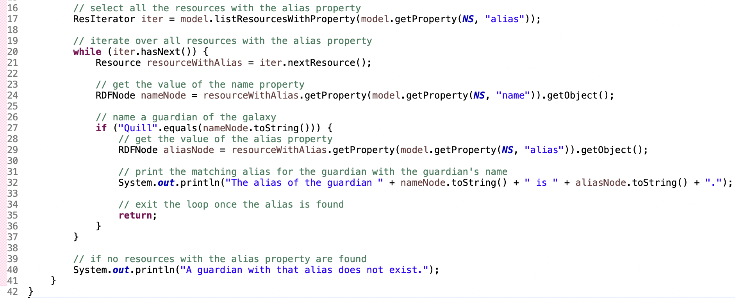
Searching for a Guardian’s Alias
Use the name of a Guardian of the Galaxy to query the “gotg.rdf” file for any member’s alias.
In this example, the alias of the Guardian with the name Quill is being searched for
(Shown in lines 27 - 35).

Slide 4
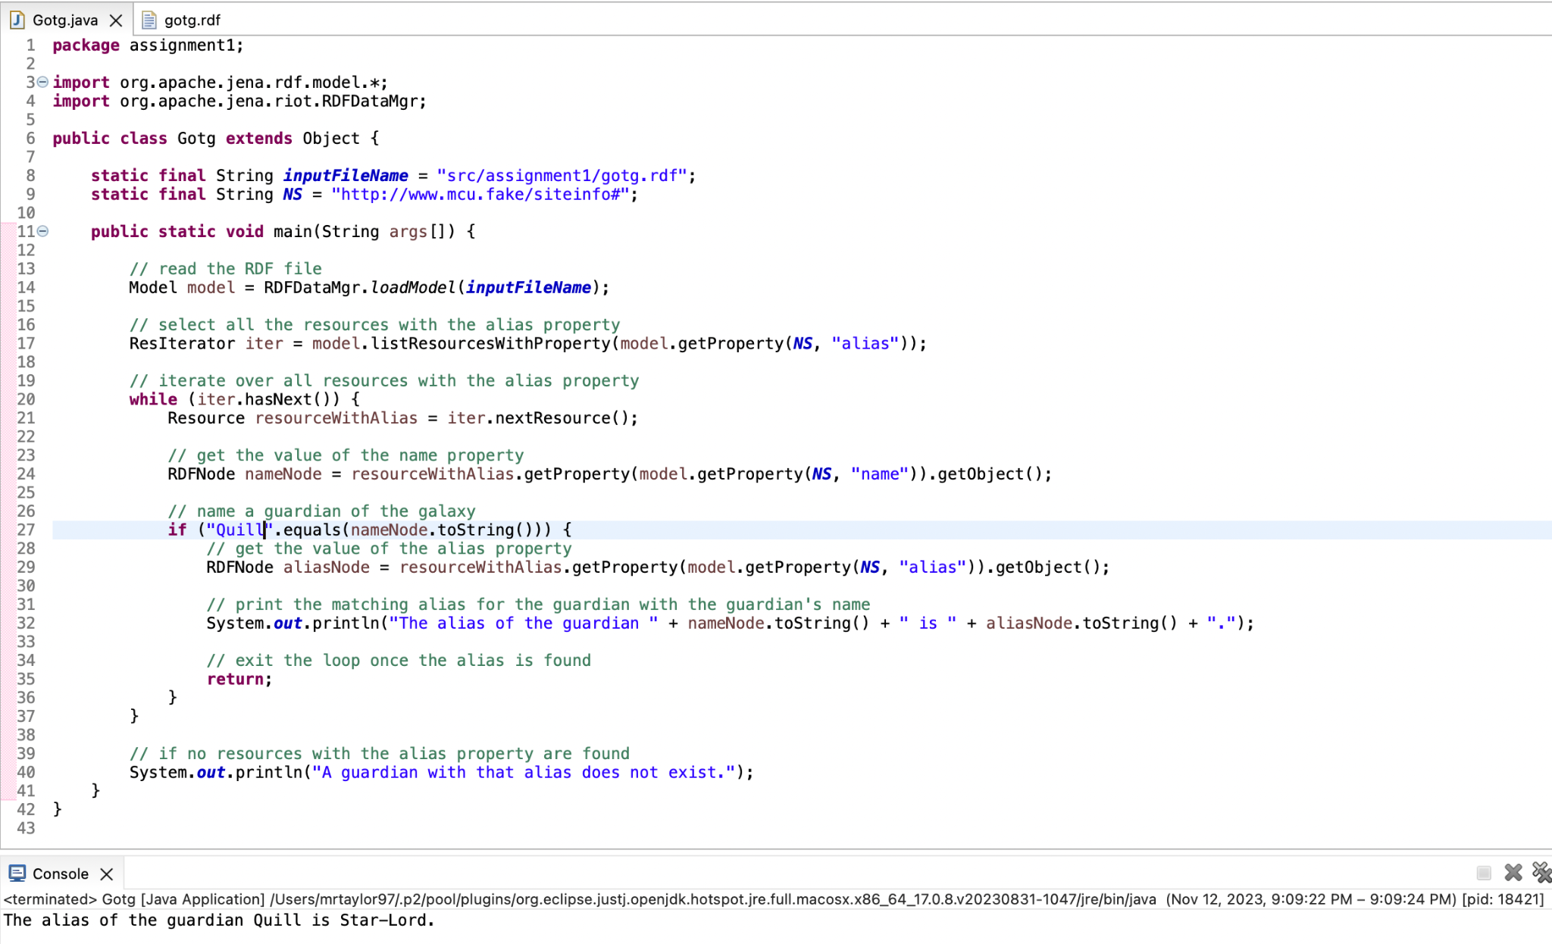
Searching for a Guardian’s Alias (Result)
When given the Guardian with the name Quill, the query returns the alias “Star-Lord” (Shown in the search results of the console).

Slide 5
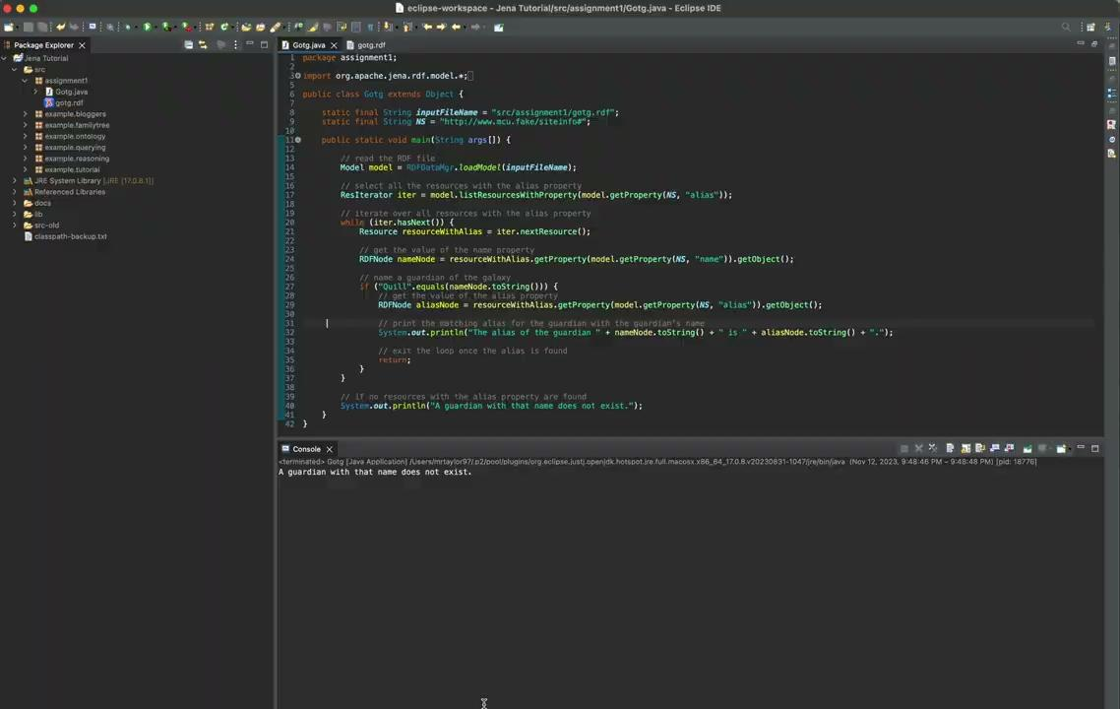
How It Works (Demo)
As shown in the last example with the name “Bill”, any name that does not belong to a member of the Guardians of the Galaxy does not return an alias.

Slide 6
Thank You!

